Slide 1
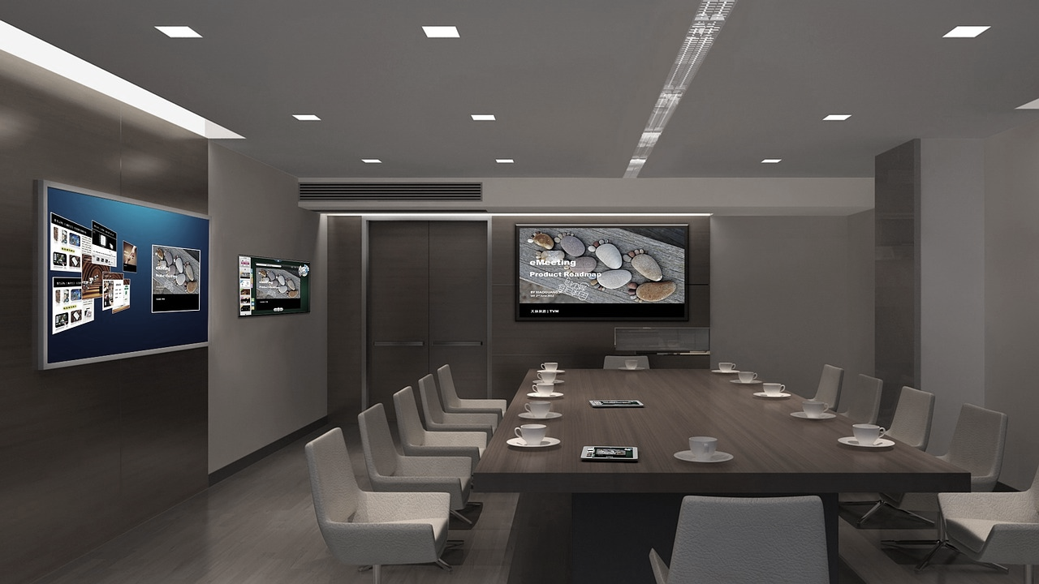
智慧互動教室 A403

Slide 2
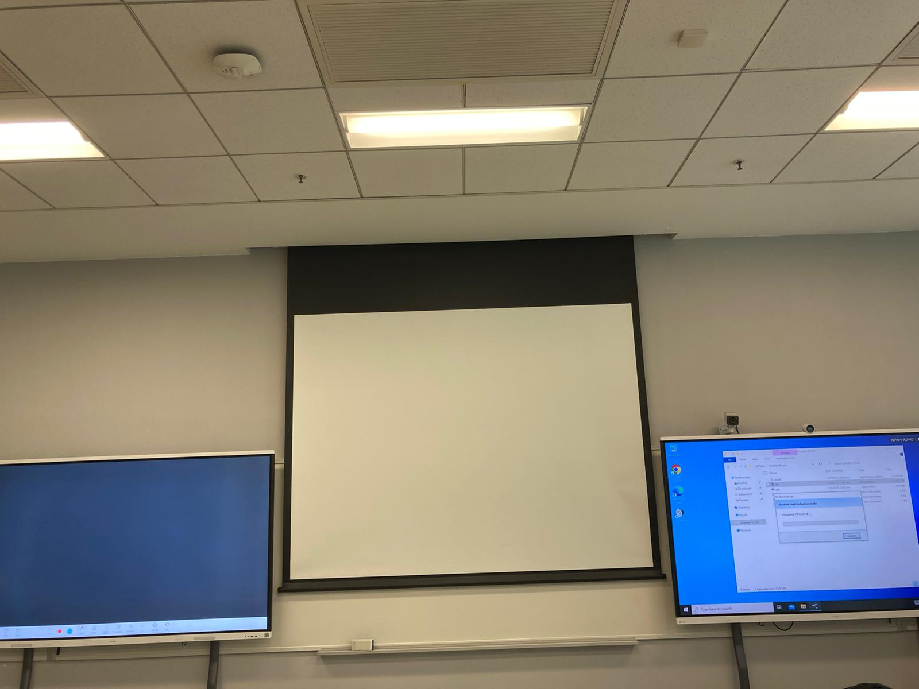
Ideahub S2 (mian board with Window PC - Right board)
Ideahub Board 2 (left board)

Slide 3
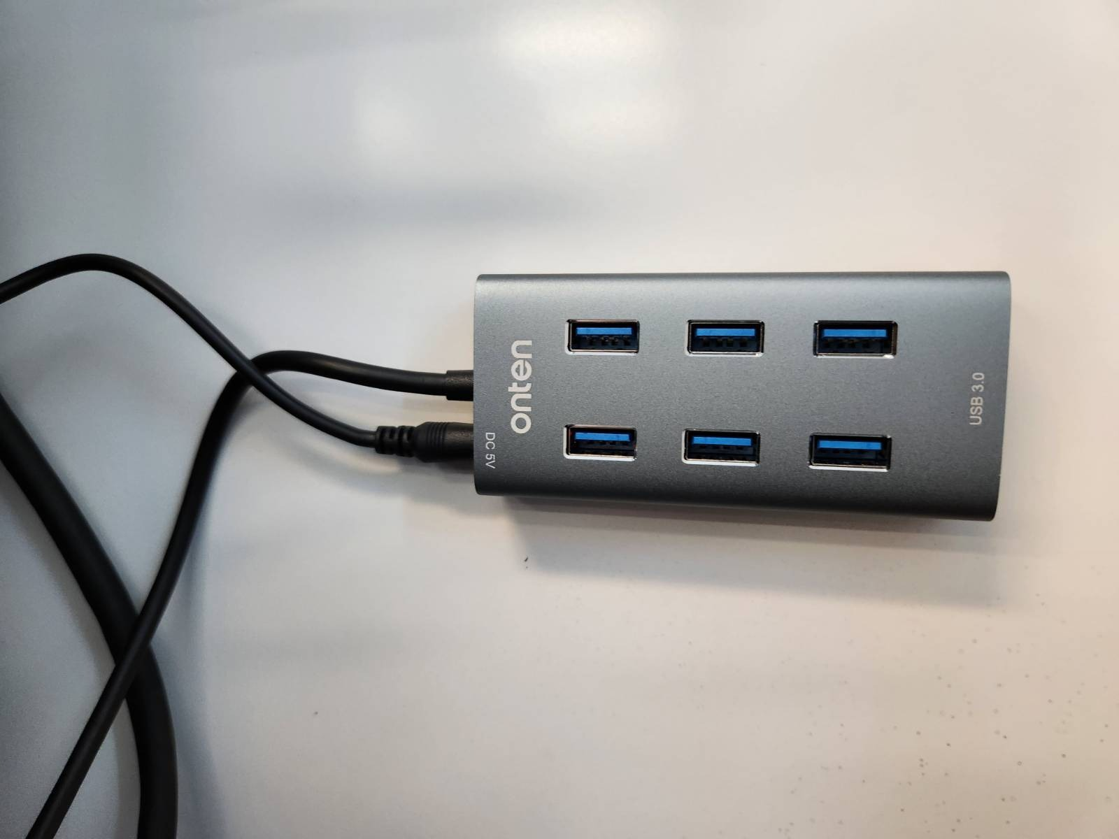
USB Connect to the Right Board’s Windows

Slide 4
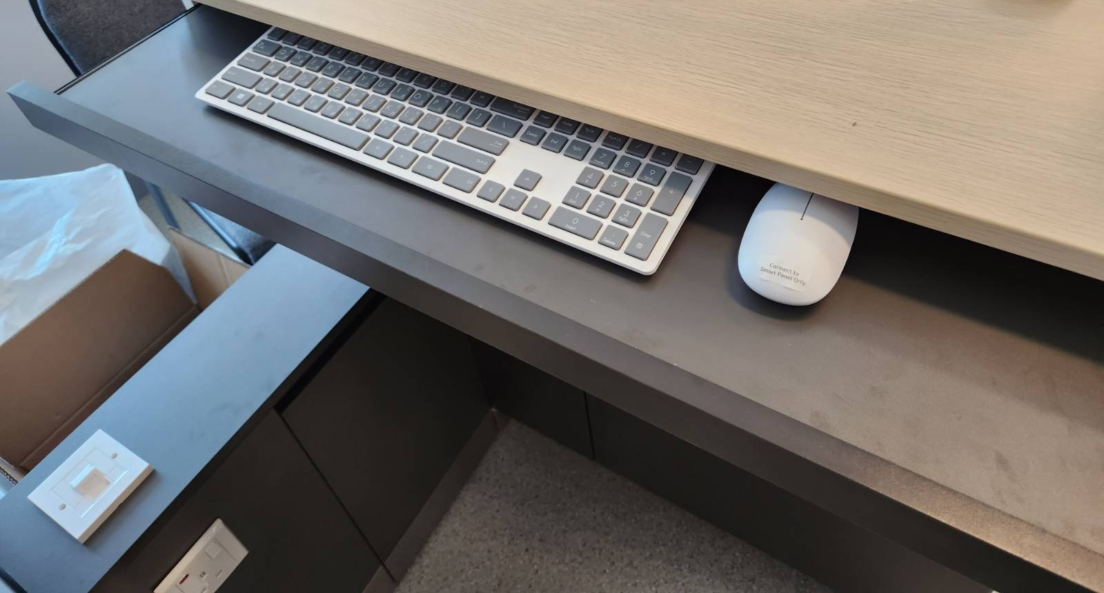
Wireless Keyboard and Mouse for the Right Board’s Windows

Slide 5
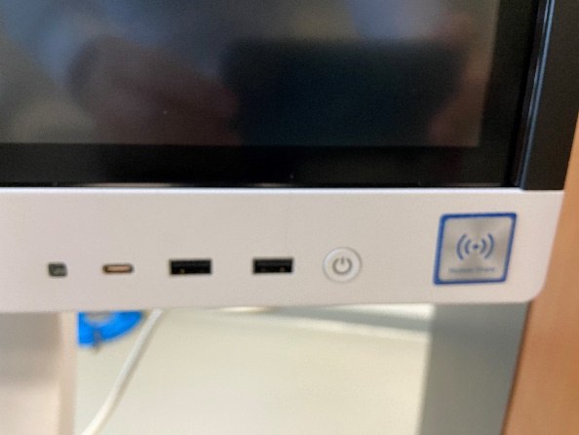
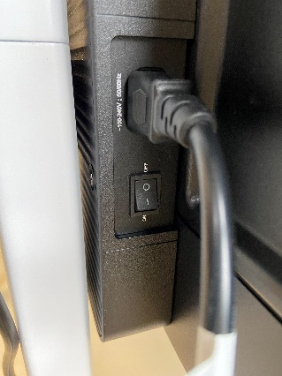
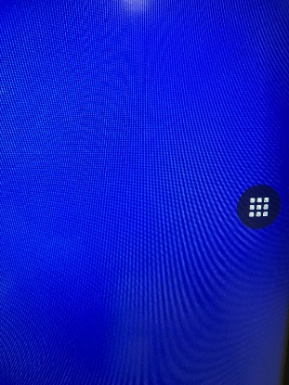
Right board Main Page
Built-in white board button
Not available for this system
Connect to ASUA VC or Ideahshare wireless dongle
1.
Turn on the Switch
2.
Turn on the Power button
3.
Short-cut Button to change the setting (both left side and right side of the panels

Slide 6
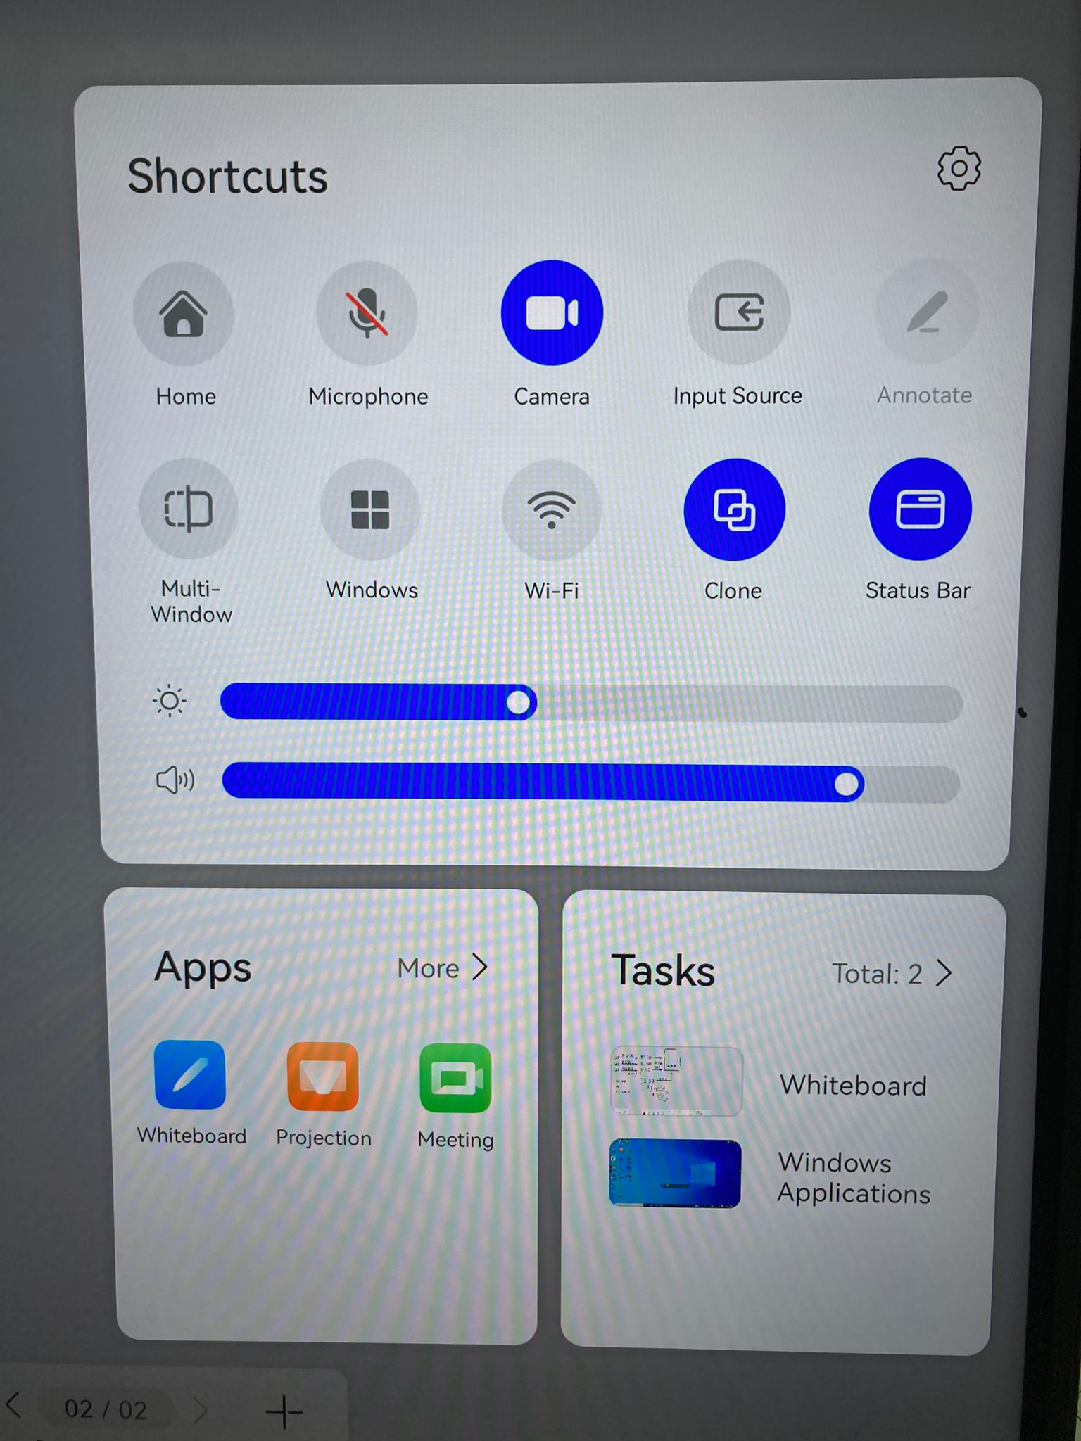
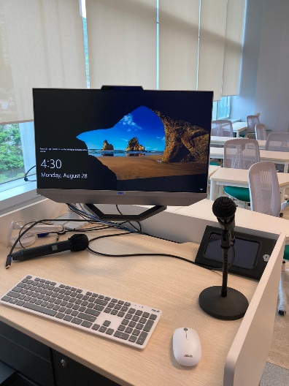
Right board short-cut
Camera (not apply in this system)
Mic on/off for video conference (right board built-in PC)
Wireless Projection for lectern ASUS PC
Screen capture and annotate on whiteboard (not on Windows)
Home (Default Screen)
Video signal sync to left board, Clone button has to be blue
Right Board built-in Windows Switching
Screen Brightness
Not apply in this system
Speaker Volume
Whiteboard

Slide 7
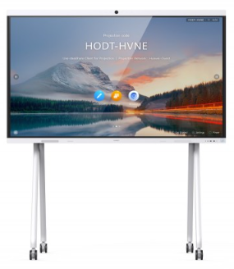
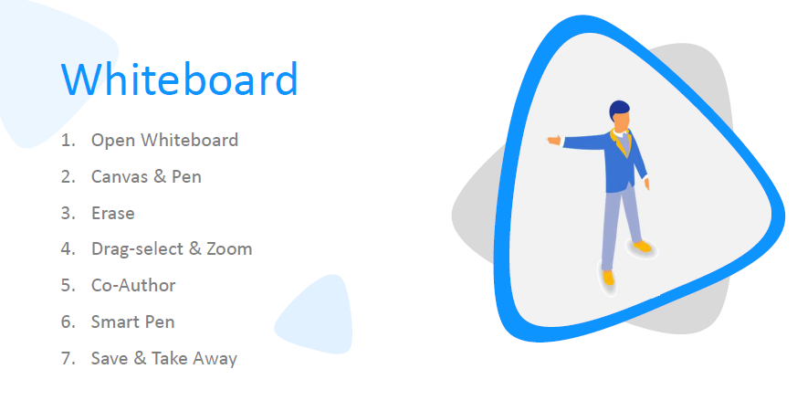
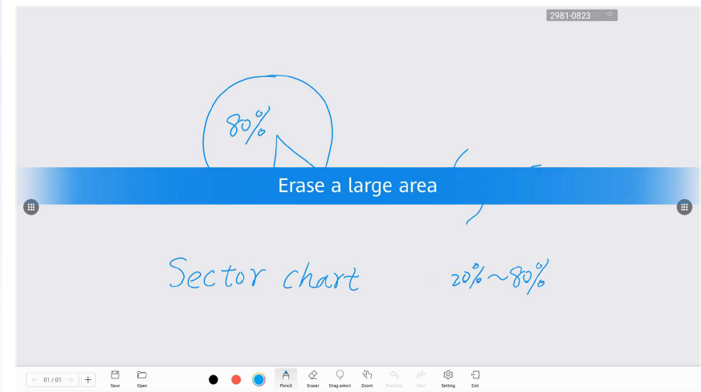
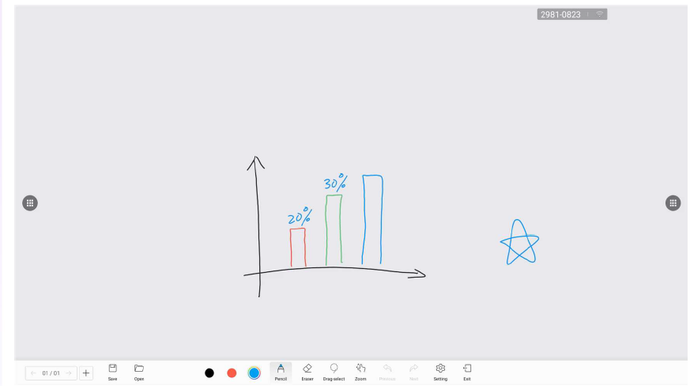
IdeaHub B2

Slide 8
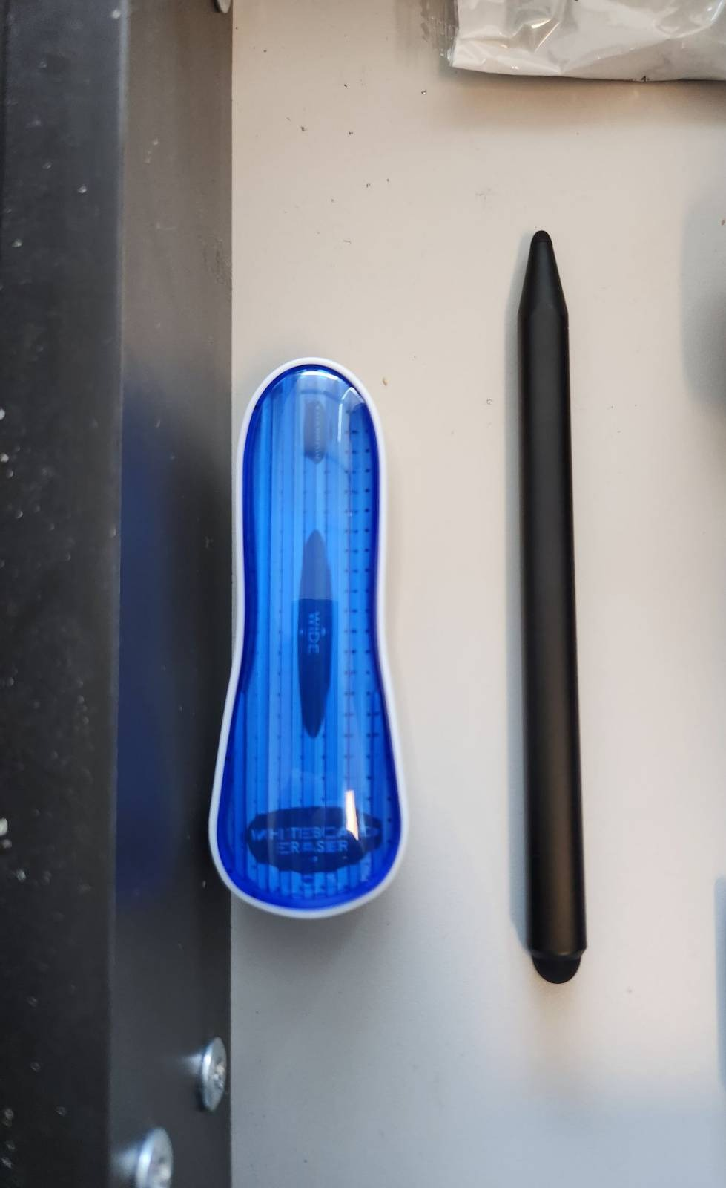
Pen and Brush for the Smart TV
You can find them in the Lectern Drawer.

Slide 9
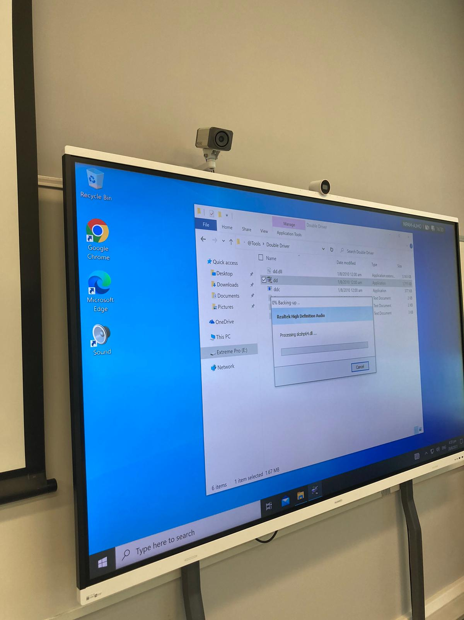
Save and take whiteboard content (both left and right board)
Save: After Whiteboard Local Storage is enabled, you can save the whiteboard content locally or export the whiteboard content to a USB flash drive (in .cwbor .pdf format).
USB-A port located at the front right of the board

Slide 10
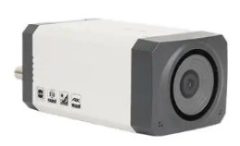
Tracking camera
Tracking camera only operate on either right board built-in PC or lectern touch PC
User can choose which PC the tracking camera connected to
By pressing USB selector button, which locate behind the right board
Blue light on 1 measn tracking camera connect board built-in PC, on 2 means ASUS PC
Tracking Camera

Slide 11
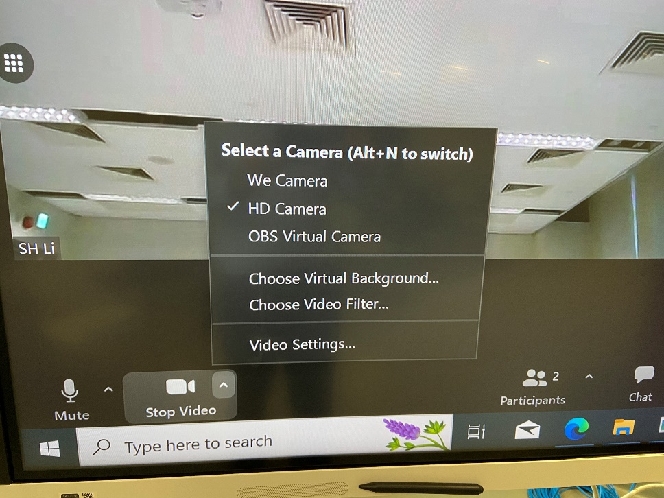
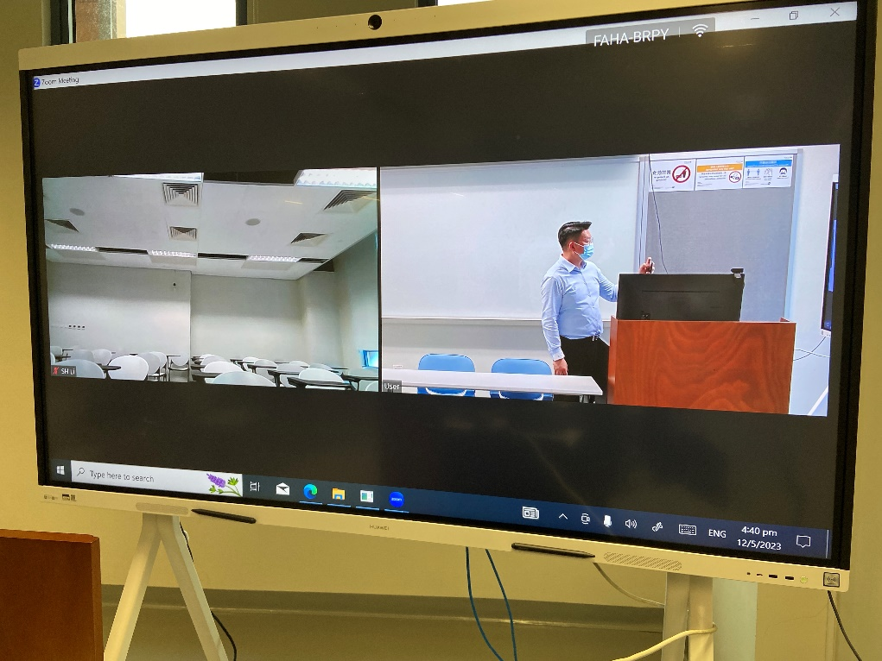
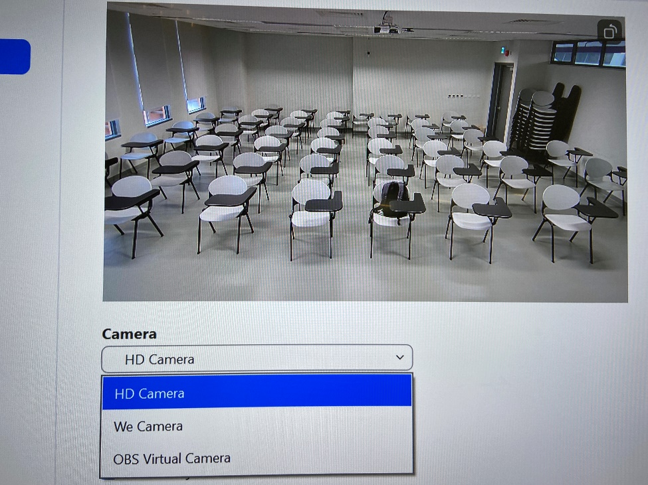
Zoom Meeting:
- Choose HD Camera (Camera tracking will follow the teacher)

Slide 12
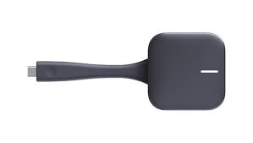
Wireless Presentation Methods to Ideahub (right board only):
Plug in the type-C USB Dongle to computer USB Port
Press the button once the LED light stip flashing and mirror the image to the screen
You need to install the IdeaShare Key app on your PC for the first time, which facilitates further projection. • Windows: Double-tap the drive or IdeaShare Key.exe in the drive path to manually complete the installation. • macOS: Double-tap IdeaShareKeySetup in the drive path, install it, and complete the authorization

Slide 13
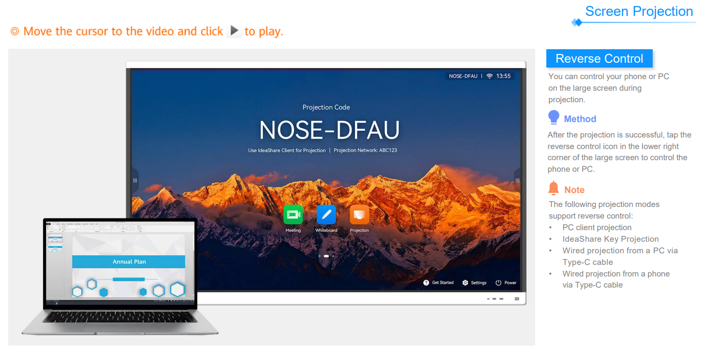

Slide 14
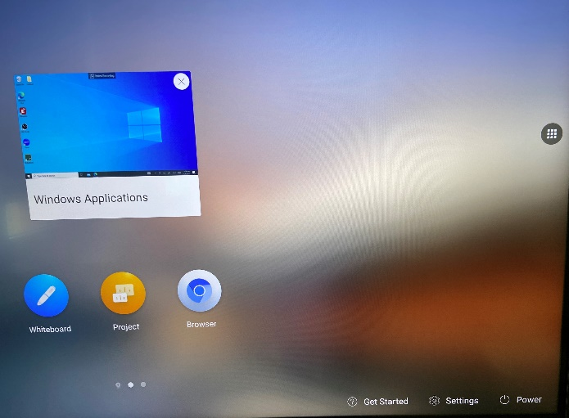
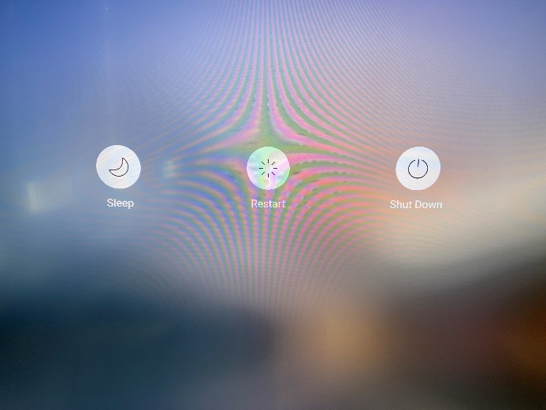
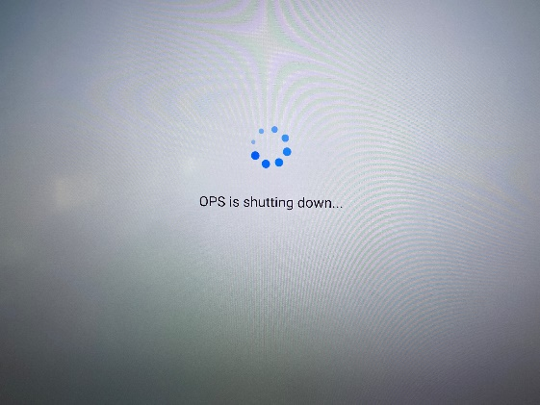
Turn off the system
1.
Menu Button
2.
Click the Power button
3.
Choose “Shut Down”
4.
OPS is Shutting down

Slide 15
Contact Us
Hong Kong Head Office
Address: | Rm 1801,18/F, One Portside, 29 Tai Yau Street, San Po Kong, Kowloon, Hong Kong
Telephone: | (852) 2121 8423
Fax: | (852) 2121 8425
Service hotline: | (852) 36934726

